Slide 1
NETWORKING AND THE INTERNET
Lecture slides are adapted/modified from slides provided by the textbook, Computer Science: An Overview by J. Glenn Brookshear and Dennis Brylow
publisher Pearson

Slide 2
Contents
Network Fundamentals
The Internet
The World Wide Web
Internet Protocols
Security
Notes:
http://www.kevinsworkbench.com/networking_quiz/study_guide.html

Slide 3
Network Fundamentals

Slide 4
Networks
Links multiple computer systems and enables them to share data and resources

Slide 5
Network Classifications
Scope
Personal area network (PAN)
Local area network (LAN)
Metropolitan area (MAN)
Wide area network (WAN)
Ownership
Closed versus open
Topology (configuration)
Bus (Ethernet)
Star (Wireless networks with central Access Point)

Slide 6
Network Fundamentals
Local Area Network (LAN)
Uses cables, radio waves, or infrared signals
Links computers in a limited geographic area
Wide Area Network (WAN)
Uses long-distance transmission media
Links computer systems a few miles or thousands of miles
Internet is the largest WAN
Metropolitan Area Network (MAN)
Designed for a city
Larger than a LAN, smaller than a WAN

Slide 7
Network Fundamentals
Campus Area Network (CAN)
Several LANs located in various locations on a college or business campus
Smaller than a WAN
Use devices such as switches, hubs, and routers
Personal Area Network (PAN)
Network of an individual’s own personal devices
Usually within a range of 32 feet
Usually use wireless technology

Slide 8
Network Fundamentals
Node
Any device connected to a network
Logical address
Unique name assigned to each node on the network
Physical address
Unique numeric that identifies each node on the network built into the hardware
Network interface card (NIC)
Expansion board or adapter that provides a connection between the computer and the network
Notebook computers have wireless NICs

Slide 9
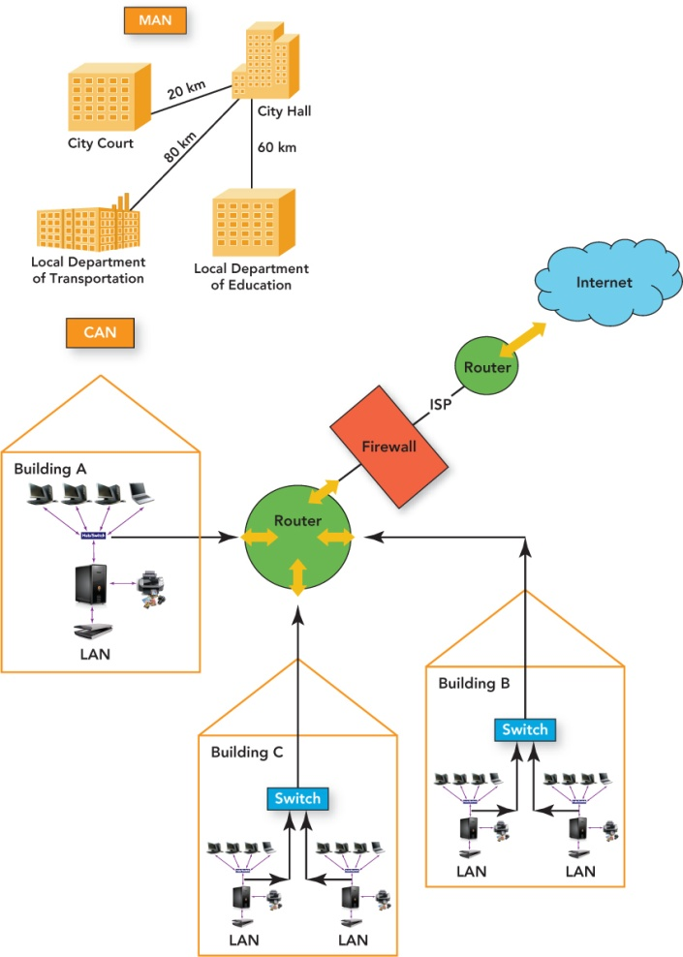

Slide 10
Network Fundamentals
USB wireless network adapter
Plugs into a USB port
Usually provides an intuitive graphical user interface (GUI) for easy configuration
Wireless PC card adapter
About the size of a credit card
Inserted into a slot on the side of most notebooks and netbooks
Has built-in WiFi antenna that provides wireless capability
LED lights that indicate whether the computer is connected

Slide 11
Network Fundamentals
USB wireless network adapter
Plugs into a USB port
Usually provides an intuitive graphical user interface (GUI) for easy configuration
USB dongle
Device inserted into a USB port that adds additional features to the base system
Examples: enabling network connectivity and increasing RAM
Wireless PC card adapter
About the size of a credit card
Inserted into a slot on the side of most notebooks and netbooks
Has built-in WiFi antenna that provides wireless capability
LED lights that indicate whether the computer is connected

Slide 12
Connecting Networks
Repeater: Extends a network
Bridge: Connects two compatible networks
Switch: Connects several compatible networks
Router: Connects two incompatible networks resulting in a network of networks called an internet

Slide 13
Network Fundamentals
Hub
Joins multiple computers together in a single network
Does not manage traffic between the connections
Switches
Filter and forward data between nodes
Are similar to routers but work within a single network
Routers
Connect two or more networks
Inspect the source and target of a data package
Determine the best route to transmit data

Slide 14
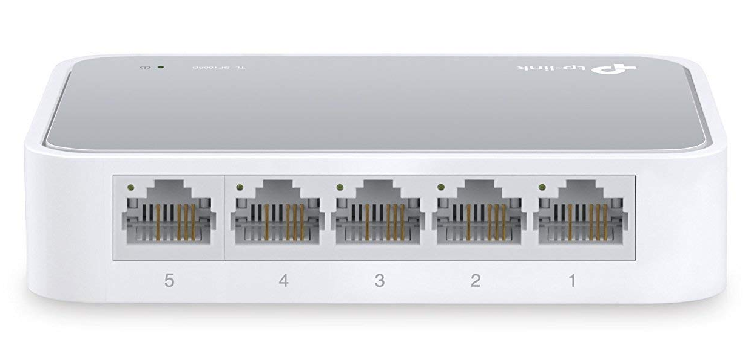
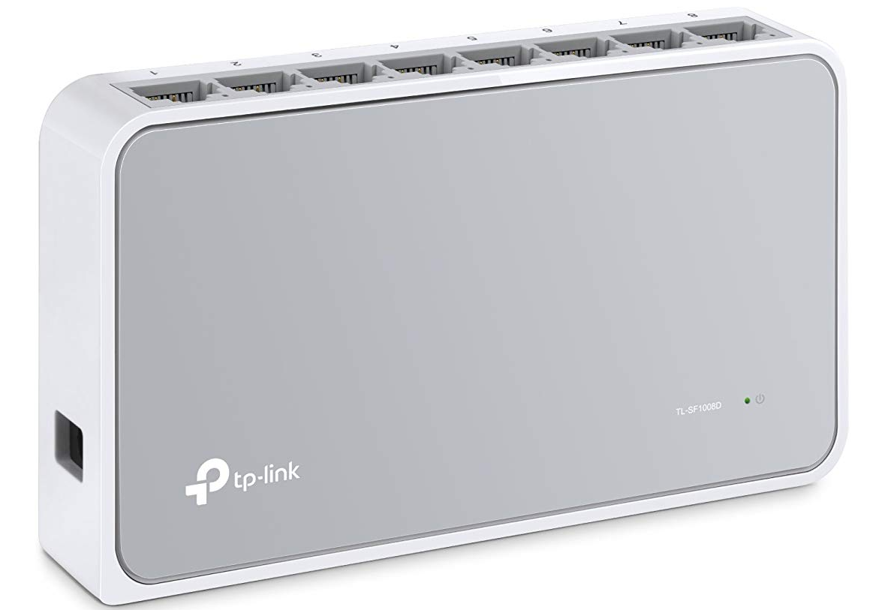
Notes:
https://www.amazon.com/TP-Link-Ethernet-Splitter-Unmanaged-TL-SF1008D/dp/B0034CL3MA/ref=pd_sim_147_3?_encoding=UTF8&pd_rd_i=B0034CL3MA&pd_rd_r=1a379213-cb03-11e8-80f2-5f2216a1cfe5&pd_rd_w=Y8D31&pd_rd_wg=n7VNj&pf_rd_i=desktop-dp-sims&pf_rd_m=ATVPDKIKX0DER&pf_rd_p=56838e6b-66d4-41e0-a762-743f1a1a628a&pf_rd_r=GJBKNFNVWKY6EHZ5SBQH&pf_rd_s=desktop-dp-sims&pf_rd_t=40701&psc=1&refRID=GJBKNFNVWKY6EHZ5SBQH

Slide 15
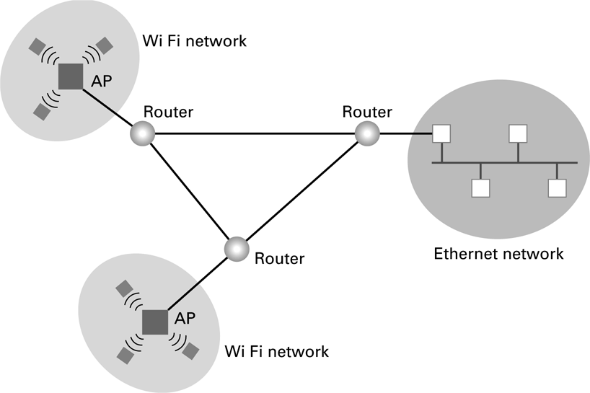
Network Fundamentals
Routers

Slide 16
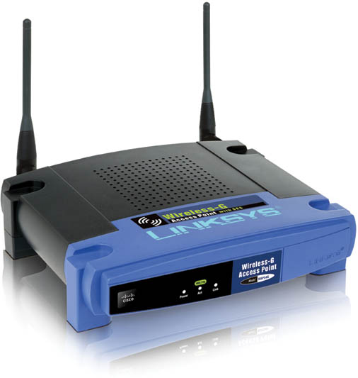
Network Fundamentals
Wireless access point (WAP)
Receives and transmits radio signals
Joins wireless nodes to a wired network

Slide 17
Network Fundamentals
Server
Computer or device with software that manages network resources, such as files, e-mails, printers, databases
File server
Most common type of server
High-speed computer that provides program and data files to network users
Contains the network operating system (NOS)
File directories for file and resource location on the LAN
Automated distribution of software updates to desktop computers on the WAN
Internet services support
Protection of services and data
Access to connected hardware by authorized users

Slide 18
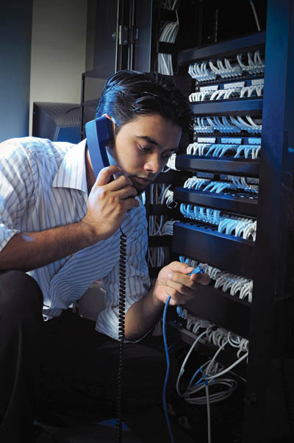
Network Fundamentals
Network administrator
Also called network engineer
Installs, maintains, supports computer networks
Interact with users
Handle security
Troubleshoot problems

Slide 19
Advantages - Disadvantages
Advantages
disadvantages
Reduced hardware costs
Application sharing
Sharing information resources
Data management centralization
Connecting people
Loss of autonomy
Lack of privacy
Security threats
Loss of productivity

Slide 20
Local Area Networks
Local area network (LAN)
Connects hardware devices that are in close proximity
The owner of the devices is also the owner of the means of communications
Common wired LAN topologies
Bus
Ring
Star

Slide 21
Local Area Networks

Slide 22
Local Area Networks
Peer-to-peer networks
Wireless LAN
Client/server LAN
Intranet

Slide 23
Peer-to-peer (P2P) networks
Share files without a file server
Easy to set up
Best used for home or small offices with no more than 10 computers
Do not require a network operating system
Can be slow if there are too many users
Security not strong

Slide 24
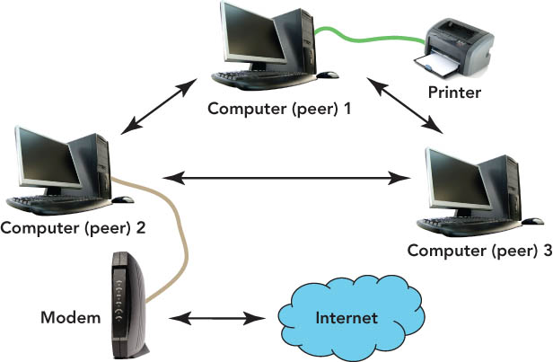
Peer-to-peer (P2P) networks

Slide 25
Wireless LAN
Connects users through radio waves instead of wires
Use includes networks in:
Homes
Hospitals
Colleges
Secured with a radio transmission technique that spreads signals over a seemingly random series of frequencies.
Effective inside range of between 125 and 300 feet

Slide 26
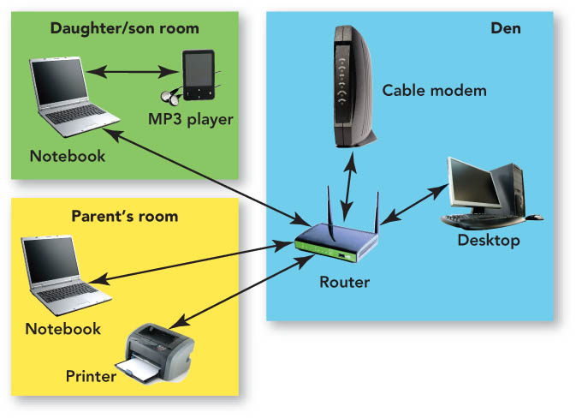
Wireless LAN

Slide 27
Client/server networks
Client/server networks
Made up of one or more file servers and clients (any type of computer)
Client software enables requests to be sent to the server
Wired or wireless connections
Do not slow down with heavy use

Slide 28
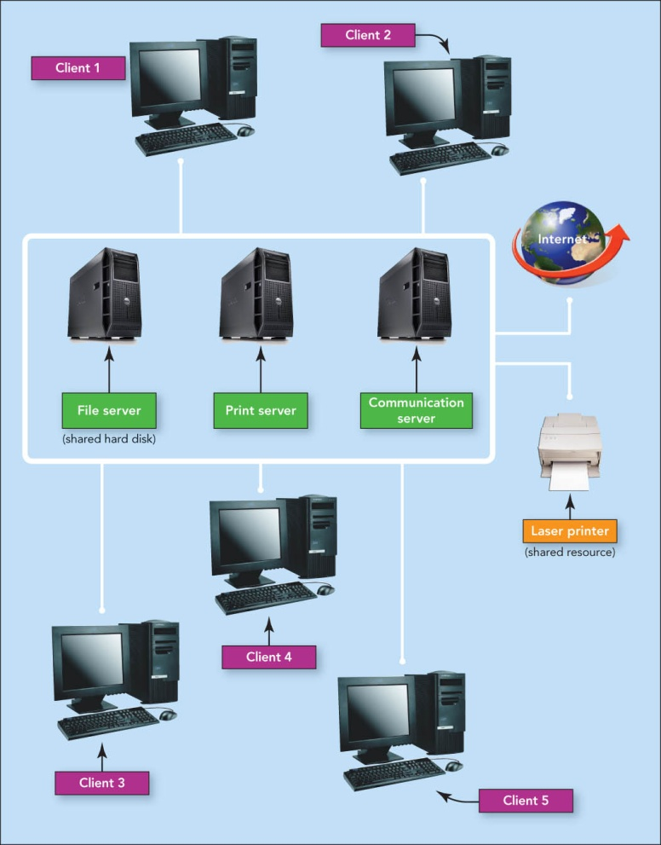
Client/server networks

Slide 29
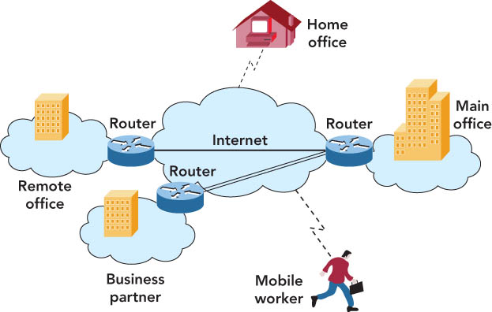
Intranet
Intranet
Password-protected network controlled by the company
Accessed only by employees
Virtual private network
Operates over the Internet
Accessible by authorized users for quick access to corporate information
Uses secure, encrypted connections and special software

Slide 30
LAN topologies
Network topology
Physical design of a LAN
Topology resolves contention—conflict that occurs when two or more computers on the network attempt to transmit at the same time
Contention sometimes results in collisions—corruption of network data caused when two computers transmit at the same time

Slide 31
LAN topologies
Bus topology
Practical for home or small office
One node transmits at a time
Terminators signify the end of the circuit
Uses contention management—technique that specifies what happens when a collision occurs
Star topology
For office buildings, computer labs, and WANs
Easy to add users
Ring topology
For a division of a company or one floor
Not in common use today
Node can transmit only when it has the token—special unit of data that travels around the ring

Slide 32
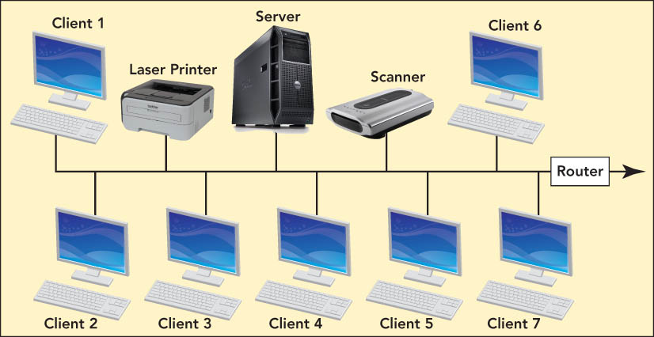
Local Area Networks

Slide 33
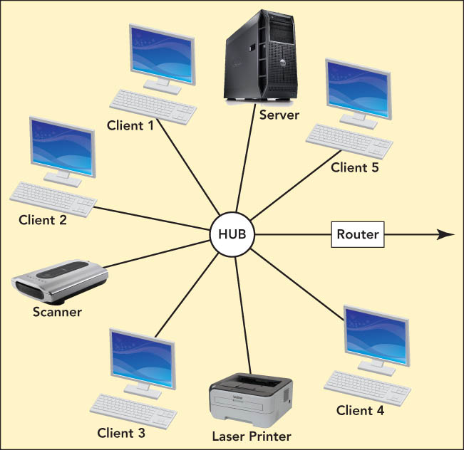
LAN topologies

Slide 34
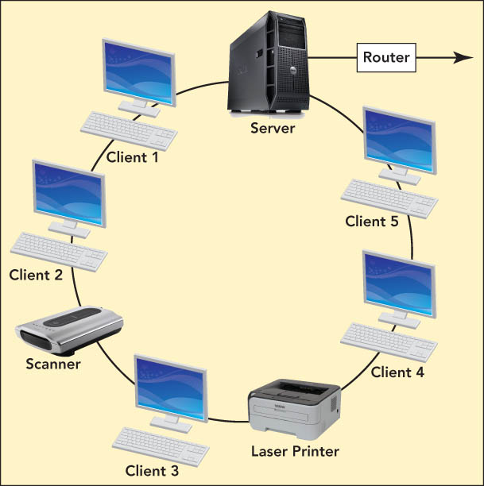
LAN topologies

Slide 35
LAN technologies
Ethernet—most-used LAN protocol
Ethernet star networks
Most popular versions—use twisted-pair wiring and switches
Sends data in a fixed-size unit called a packet
WiFi
Uses radio waves to provide a wireless LAN standard at Ethernet speeds
Needs a central access point—could be a wireless router
Hot spots—public wireless access locations

Slide 36
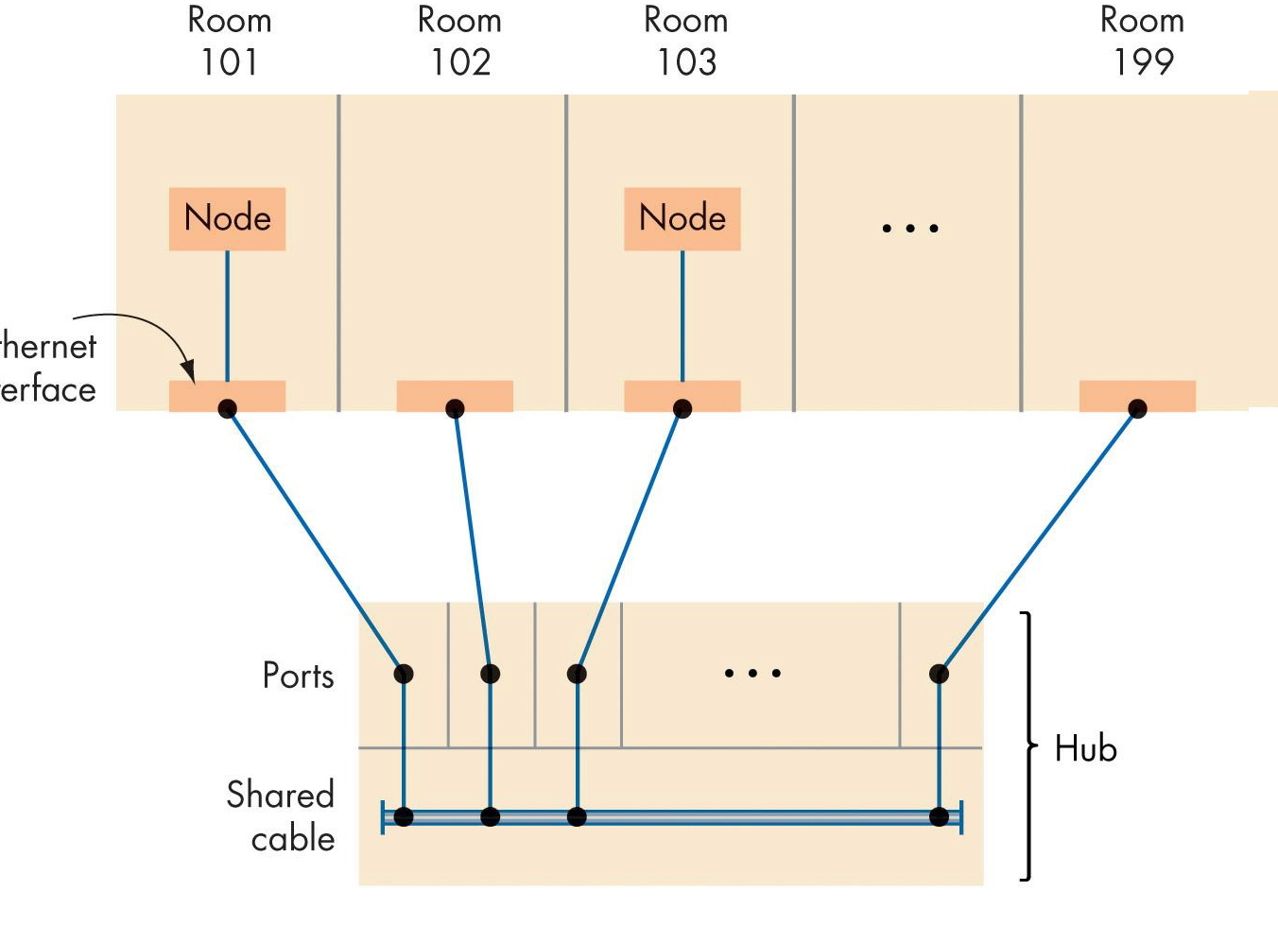
Figure 7.6
An Ethernet LAN Implemented Using a Hub

Slide 37
Local Area Networks (continued)
Ethernet
Most widely used LAN technology
Uses the bus topology
Two ways to construct an Ethernet LAN
Shared cable
Hubs: The most widely used technology

Slide 38
Protocols
CSMA/CD (Carrier Sense, Multiple Access with Collision Detection)
Used in Ethernet
Silent bus provides right to introduce new message
CSMA/CA (Carrier Sense, Multiple Access with Collision Avoidance)
Used in WiFi
Hidden terminal problem

Slide 39
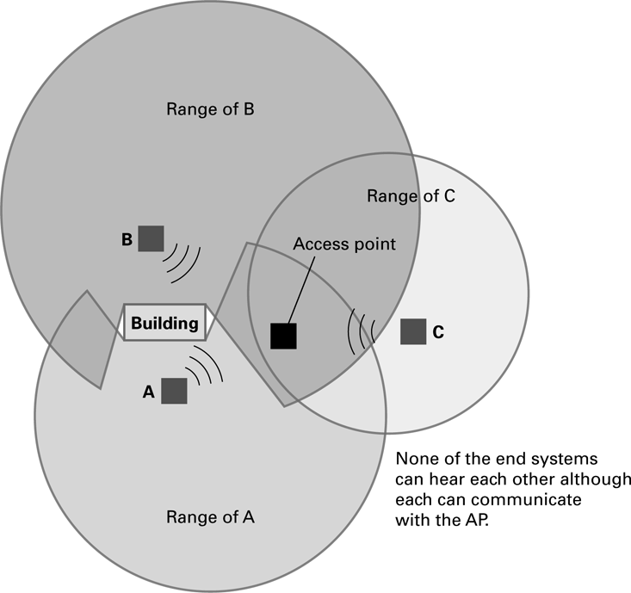
The hidden terminal problem

Slide 40
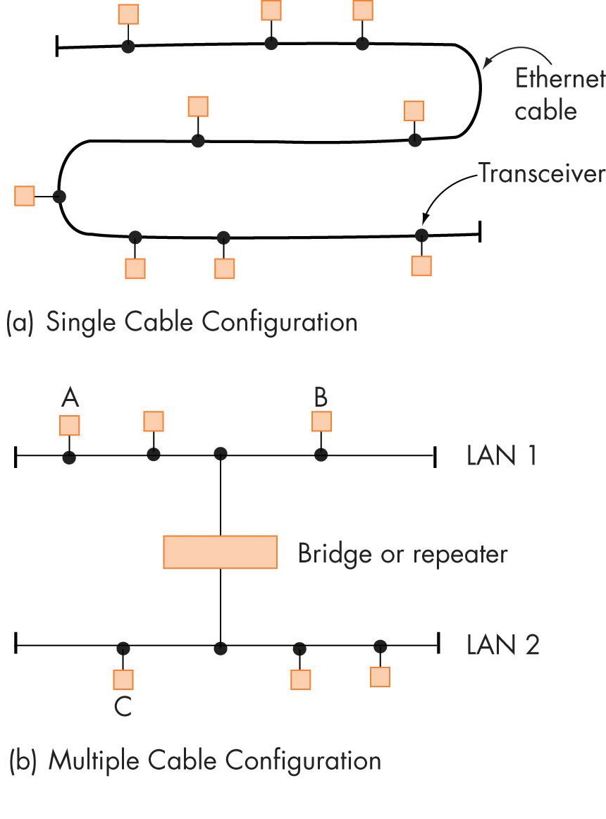
Figure 7.5
An Ethernet LAN Implemented
Using Shared Cables

Slide 41
Figure 7.5
An Ethernet LAN Implemented
Using Shared Cables

Slide 42
Wide Area Networks

Slide 43
Wide Area Networks
Wide area networks (WANs)
Connect devices that are across town, across the country, or across the ocean
Users must purchase telecommunications services from an external provider
Dedicated point-to-point lines
Most use a store-and-forward, packet-switched technology to deliver messages

Slide 44
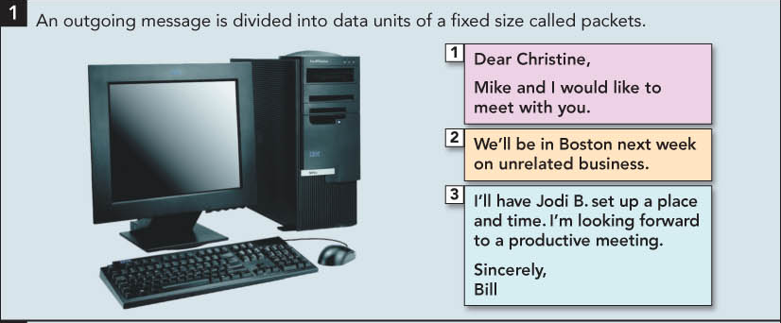
Wide Area Networks

Slide 45
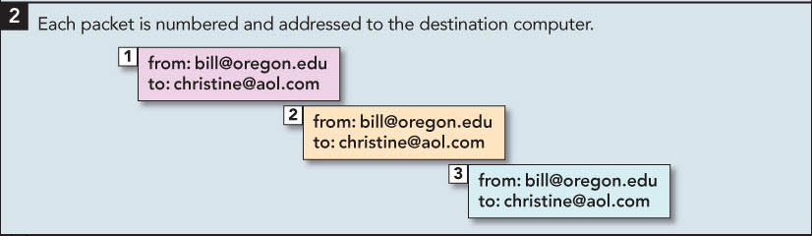
Wide Area Networks

Slide 46
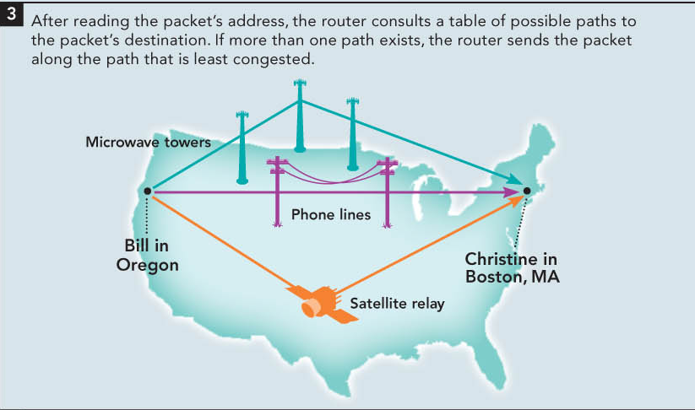
Wide Area Networks

Slide 47
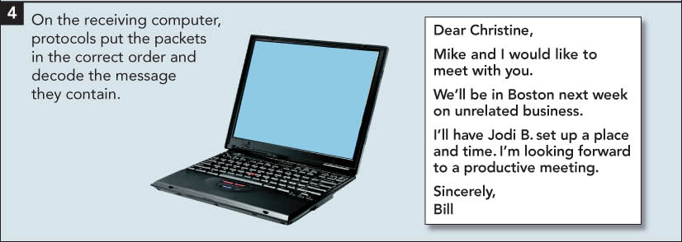
Wide Area Networks

Slide 48
WAN applications
E-mail, conferencing, document exchange, remote database access
LAN to LAN connections connect two or more geographically separate locations
Transaction acquisition—the instant relay of transaction information from a point-of-purchase sale.

Slide 49
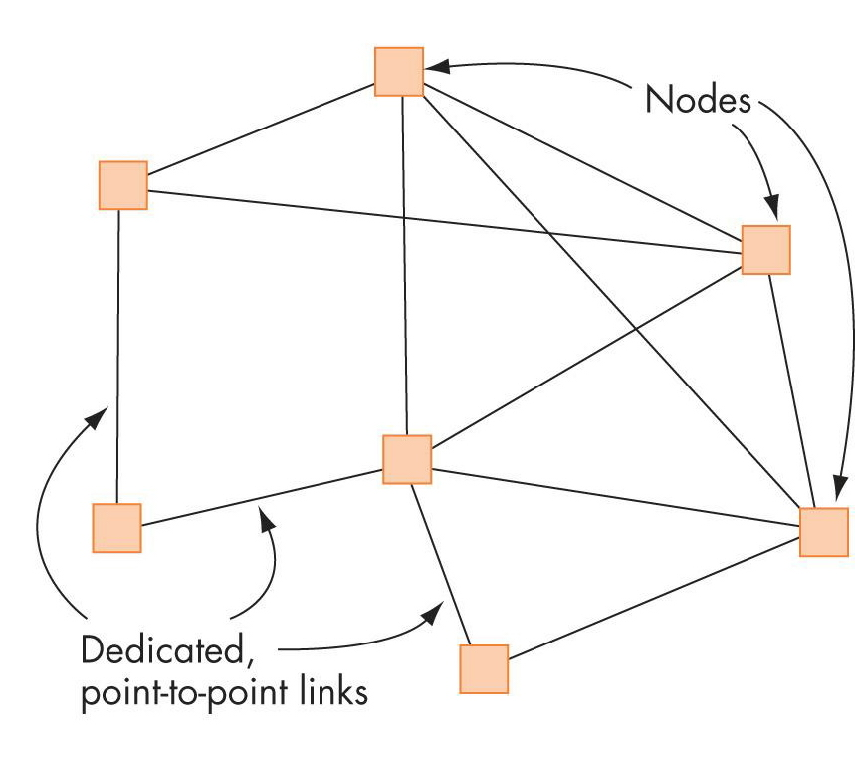
Figure 7.7
Typical Structure of a Wide Area Network

Slide 50
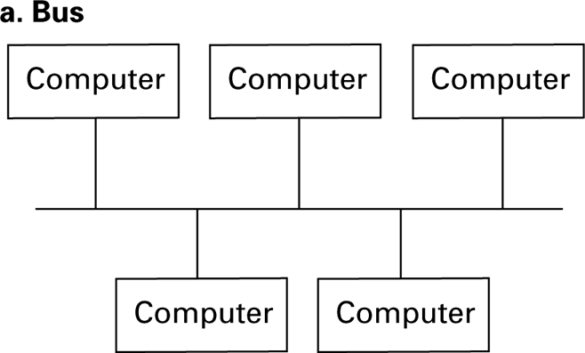
Figure 4.1 Network topologies

Slide 51
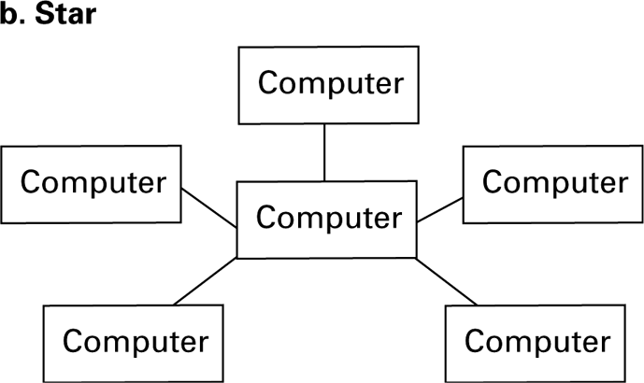
Figure 4.1 Network topologies (continued)

Slide 52
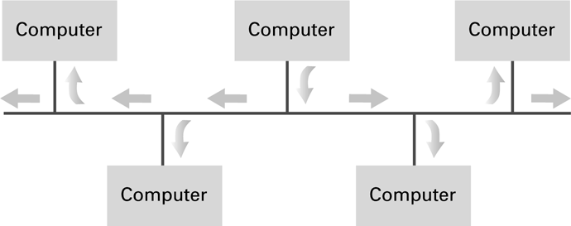
Figure 4.2 Communication over a bus network

Slide 53
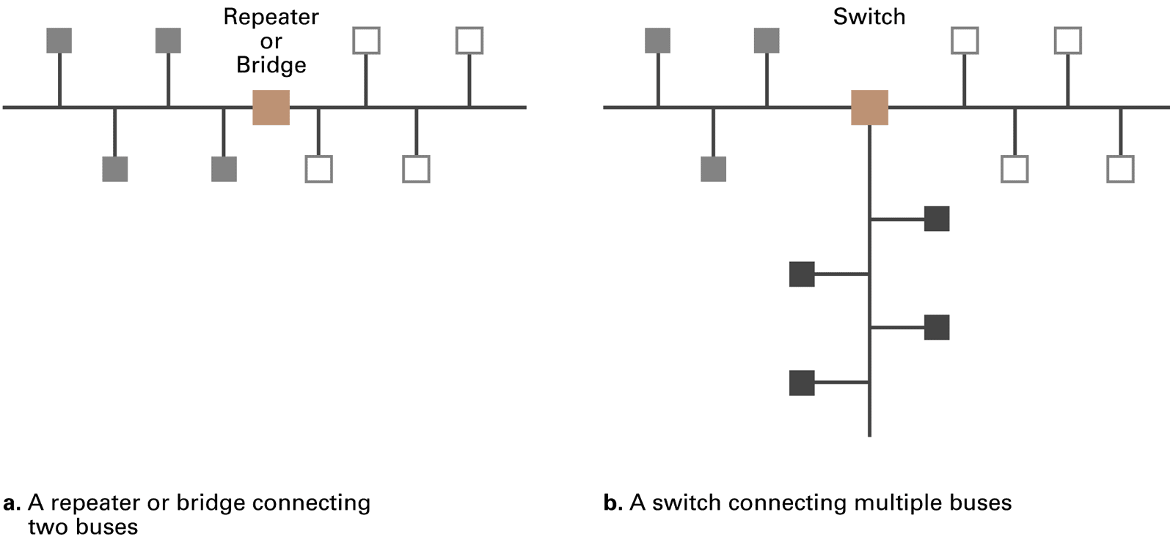
Building a large bus network from smaller ones

Slide 54
Routers

Slide 55
Inter-process Communication
Client-server
One server, many clients
Server must execute continuously
Client initiates communication
Peer-to-peer (P2P)
Two processes communicating as equals
Peer processes can be short-lived

Slide 56
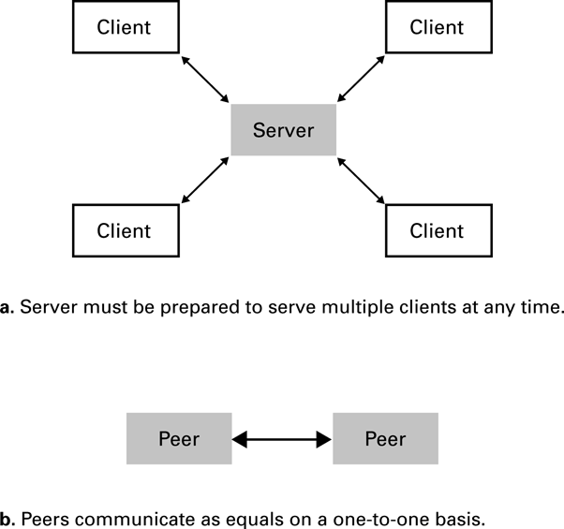
Figure 4.6 The client/server model compared to the peer-to-peer model

Slide 57
Distributed Systems
Systems with parts that run on different computers
Cluster computing
Grid computing
Cloud computing
Amazon’s Elastic Compute Cloud
Google Drive

Slide 58
The Internet

Slide 59
The Internet
The Internet: An internet that spans the world
Original goal was to develop a means of connecting networks that would not be disrupted by local disasters
Today a commercial undertaking that links a worldwide combination of PANs, LANs, MANs, and WANs involving millions of computers

Slide 60
Internet Architecture
Internet Service Provider (ISP)
Tier-1
Tier-2
Access or tier-3 ISP: Provides connectivity to the Internet
Hot spot (wireless)
Telephone lines
Cable/Satellite systems DSL
Fiber optics

Slide 61
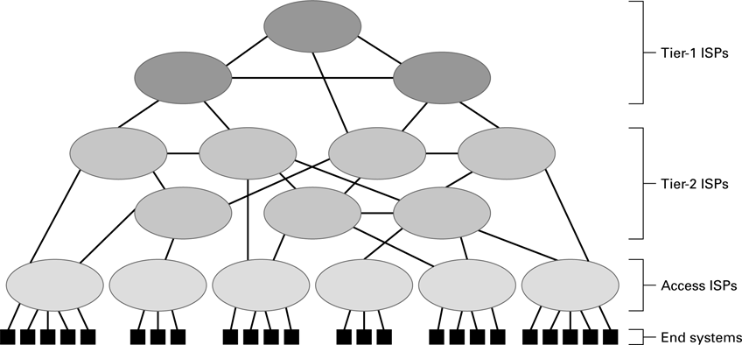
Internet Composition

Slide 62
Internet Addressing
IP address: pattern of 32 or 128 bits often represented in dotted decimal notation
Mnemonic address:
Domain names
Top-Level Domains
Domain name system (DNS)
Name servers
DNS lookup

Slide 63
ICANN
Internet Corporation for Assigned Names & Numbers (ICANN)
Allocates IP addresses to ISPs who then assign those addresses within their regions.
Oversees the registration of domains and domain names.

Slide 64
Early Internet Applications
Network News Transfer Protocol (NNTP)
File Transfer Protocol (FTP)
Telnet and SSH (Secured Shell)
Hypertext Transfer Protocol (HTTP)
Electronic Mail (email)
Domain mail server collects incoming mail and transmits outing mail
Mail server delivers collected incoming mail to clients via POP3 (Post Office Protocol version 3) or IMAP (Internet Mail Access Protocol)

Slide 65
SMTP Simple Mail Transfer Protocol
220 mail.tardis.edu SMTP Sendmail Gallifrey-1.0; Fri, 23 Aug 2413 14:34:10
HELO mail.skaro.gov
250 mail.tardis.edu Hello mail.skaro.gov, pleased to meet you
MAIL From: dalek@skaro.gov
250 2.1.0 dalek@skaro.gov... Sender ok
RCPT To: doctor@tardis.edu
250 2.1.5 doctor@tardis.edu... Recipient ok
DATA
354 Enter mail, end with "." on a line by itself
Subject: Extermination.
EXTERMINATE!
Regards, Dalek
.
250 2.0.0 r7NJYAEl028071 Message accepted for delivery
QUIT
221 2.0.0 mail.tardis.edu closing connection

Slide 66
More Recent Applications
Voice Over IP (VoIP)
Internet Multimedia Streaming
N-unicast
Multicast
On-demand streaming
Content delivery networks (CDNs)

Slide 67
World Wide Web

Slide 68
World Wide Web
Hypertext combines internet technology with concept of linked-documents
Embeds hyperlinks to other documents
Browsers present materials to the user
Webservers provide access to documents
Documents are identified by URLs and transferred using HTTP

Slide 69
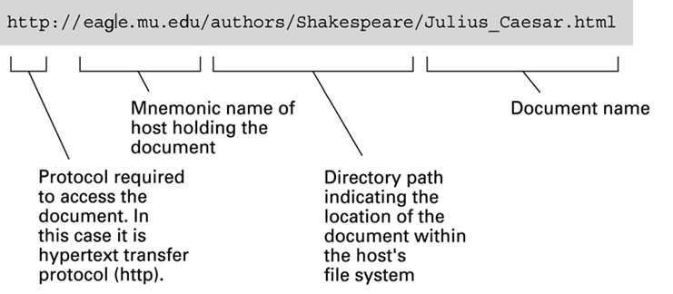
A typical URL

Slide 70
Hypertext Markup Language (HTML)
Encoded as text file
Contains tags to communicate with browser
Appearance
<h1> to start a level one heading
<p> to start a new paragraph
Links to other documents and content
<a href = . . . >
Insert images
<img src = . . . >

Slide 71
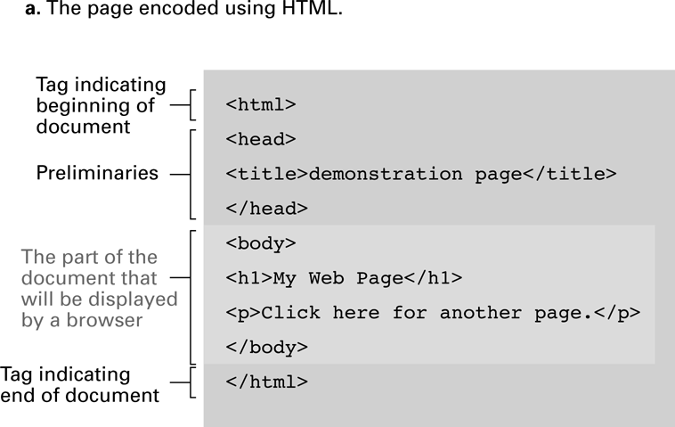
A simple webpage

Slide 72
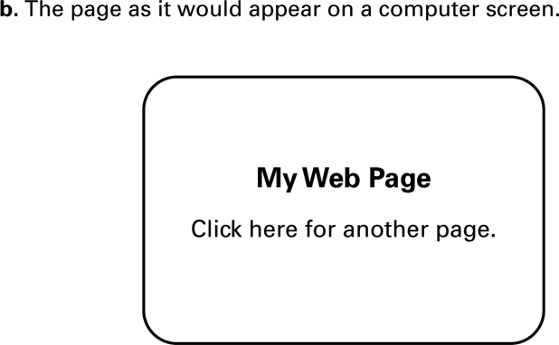
A simple webpage

Slide 73
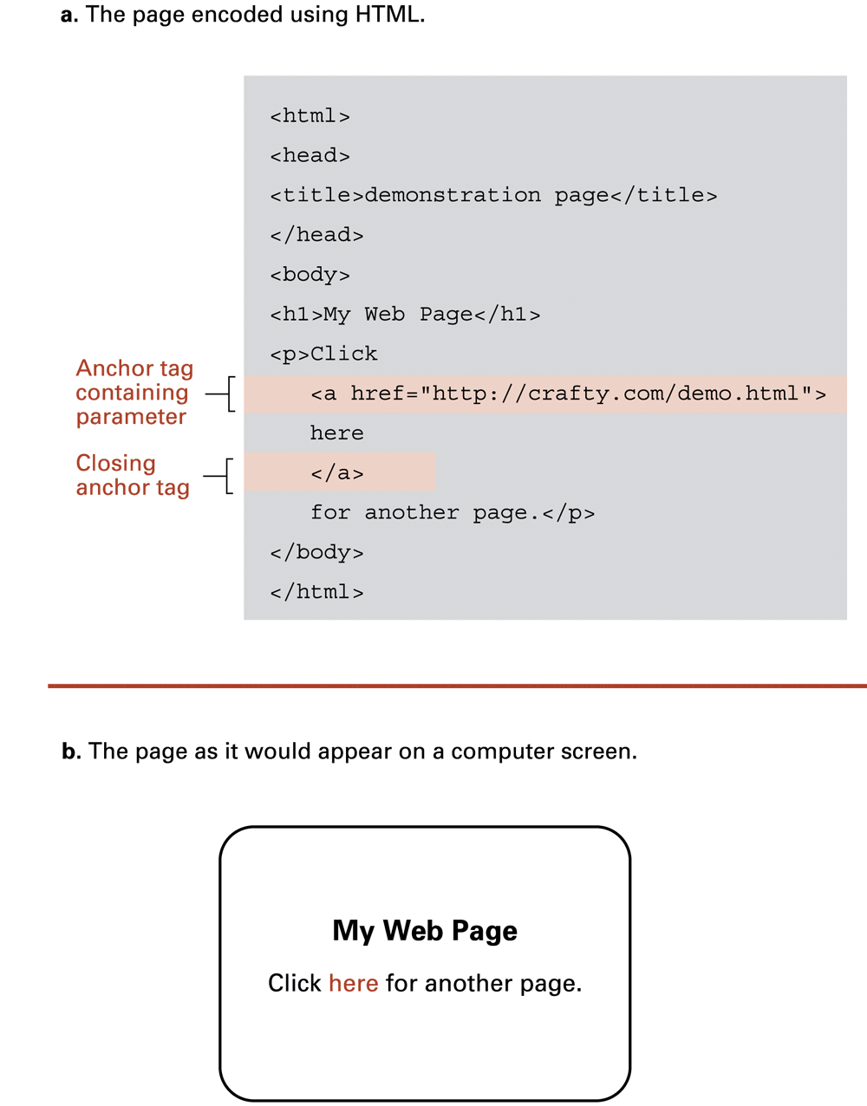
An enhanced simple webpage

Slide 74
An enhanced simple Web page

Slide 75
Extensible Markup Language (XML)
XML: A language for constructing markup languages similar to HTML
A descendant of SGML
Opens door to a World Wide Semantic Web

Slide 76
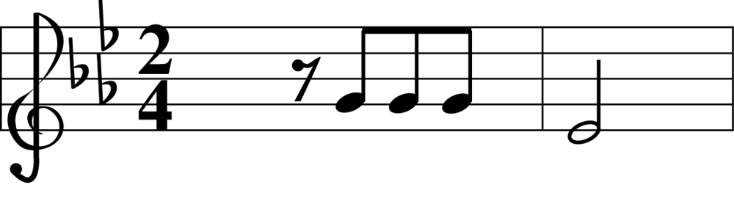
Using XML
<staff clef = "treble"> <key>C minor</key>
<time> 2/4 </time>
<measure> <rest> egth </rest> <notes> egth G, egth G, egth G </notes></measure>
<measure> <notes> hlf E </notes></measure>
</staff>

Slide 77
Client Side Versus Server Side
Client-side activities
Javascript
Macromedia Flash
Server-side activities
Common Gateway Interface (CGI)
Servlets
JavaServer Pages (JSP) / Active Server Pages (ASP)
PHP

Slide 78
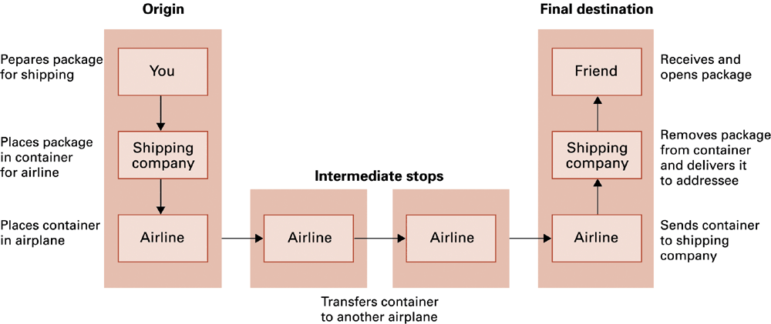
Package-shipping example

Slide 79
Internet Software Layers
Application: Constructs message with address
Transport: Chops message into packets
Network: Handles routing through the Internet
Link: Handles actual transmission of packets

Slide 80
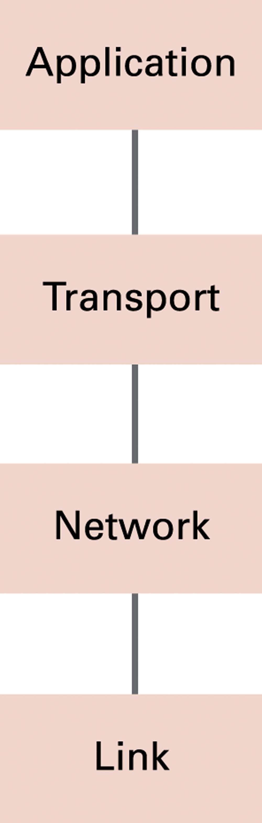
The Internet software layers

Slide 81
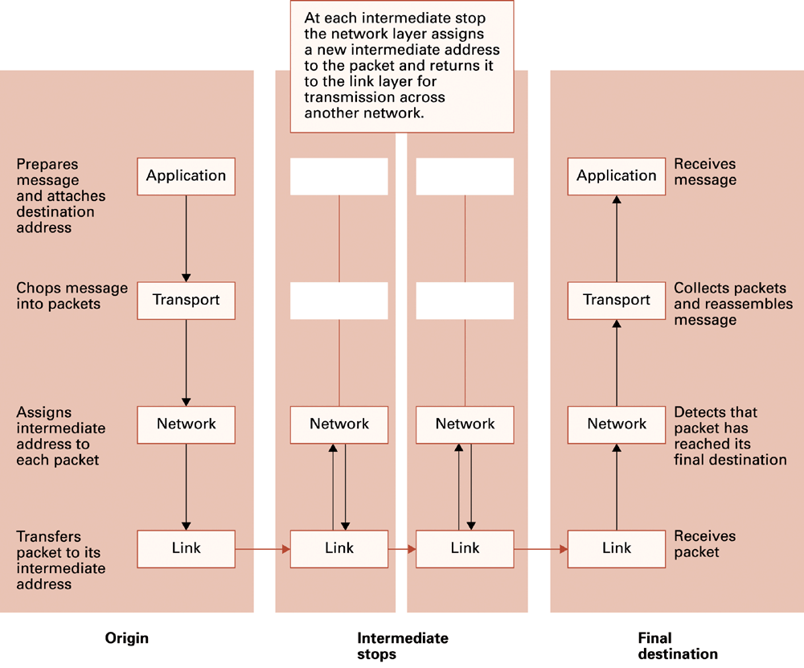
A message through the Internet

Slide 82
TCP/IP Protocol Suite
Transport Layer
Transmission Control Protocol (TCP): break down messages or files into smaller pieces (called packets). When receiving, reassembles the data into a complete file or message. provide error-checking if an error is found TCP retransmits the packet(s).
User Datagram Protocol (UDP): UDP does not divide each transmission into packets, which allows for a faster transmission. does not provide error checking.
Network Layer
Internet Protocol (IP)
IPv4
IPv6

Slide 83
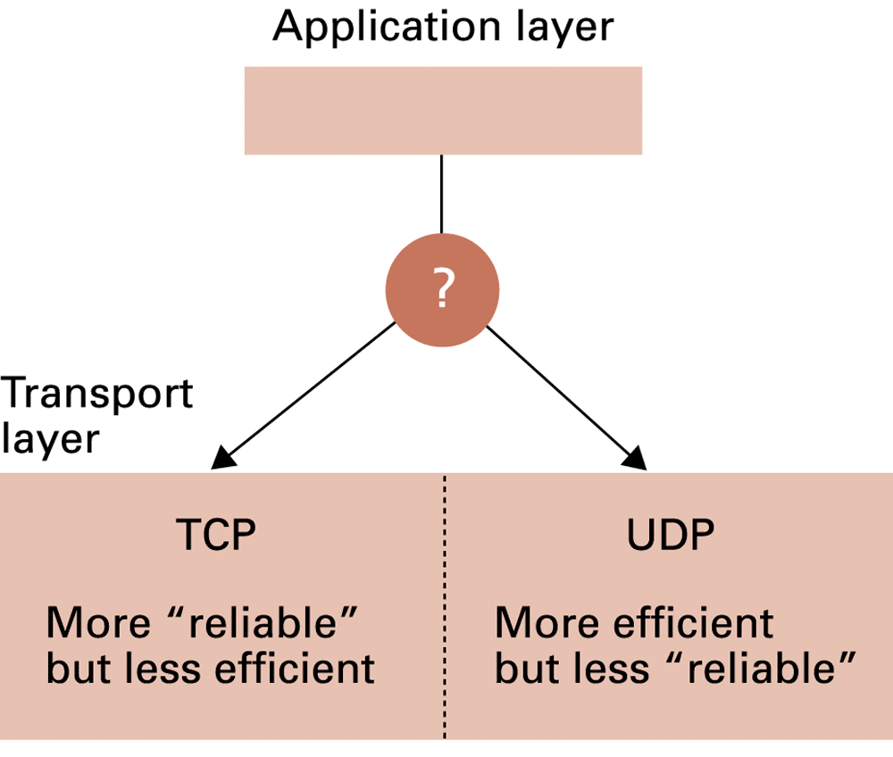
Choosing between TCP and UDP

Slide 84
Security

Slide 85
Security
Attacks
Malware (viruses, worms, Trojan horses, spyware, phishing software)
Denial of service (DoS)
Spam
Protection
Firewalls
Spam filters
Proxy Servers
Antivirus software

Slide 86
Types of computer crime
Identify theft—criminal access to personal information in order to impersonate someone
Dumpster diving—disgruntled employees or thieves go through a company’s trash to find information they can steal
Phishing attacks—legitimate-looking e-mails or Web sites created in an attempt to obtain confidential data about a person
Spear phishing (similar to phishing)—uses targeted fake e-mails and social engineering to trick recipients into providing personal information to enable identity theft

Slide 87
Types of computer crime
Malware (short for malicious software)—programs that intentionally harm a computer system or allow individuals to gain access without permission
Tips to protect yourself from malware:
Know who you are dealing with
Keep your Web browser and operating system up to date
Back up important files
Protect children online
Use security software tools and keep them up to date
Use strong passwords
Learn what to do if something goes wrong

Slide 88
Types of computer crime
Spyware—software that gathers private information and tracks Web use
Adware—form of spyware that generates annoying pop-up and banner ads
Keyloggers—record keystrokes to provide cybercriminals with confidential data

Slide 89
Types of computer crime
Computer virus—code concealed inside a program that can harm or destroy files
Many spread through e-mail attachments
File infectors—attach themselves to files
Payload—refers to the dangerous actions a virus performs.
Macro viruses—attach to data files and take advantage of application macros
Boot sector viruses—execute each time you start the computer
SPIM—spam text message sent via a cell phone or instant messaging service

Slide 90
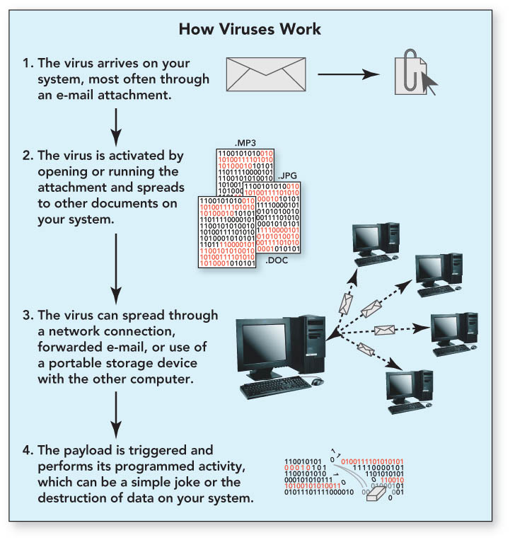
Computer Crime and Cybercrime

Slide 91
Types of computer crime
Rogue programs
Logic bomb—hidden computer code that sits dormant on a system until triggered
Time bomb—virus program that remains dormant on a computer system until activated
Worm—similar to a virus but does not need action of a user to execute

Slide 92
Types of computer crime
Denial of service (DoS) attack—assaults an Internet server with so many requests it can’t function
Distributed denial of service (DDoS)—attack involves multiple computer systems
Commandeered computers form a botnet (robot network)
Bot (short for robot)—connects individual computers to the controller, usually a server under the control of the botnet controller
The individual computers are called zombies.

Slide 93
Computer Crime and Cybercrime
More rogue programs (con’t.)
Syn flooding—form of denial of service attack in which synchronization packets are repeatedly sent to every port on the server
Uses up all available network connections
Locks them until they time out
Rootkit—malicious program that is disguised as a useful program
Enables attacker to gain administrator level access
Allows attacker to have repeated and undetected access
Trojan horse—normal-looking program that includes concealed instructions to cause harm

Slide 94
Computer Crime and Cybercrime
Fraud, theft, and piracy
Memory shaving
Software piracy
Cybergaming crime
Tricks for obtaining passwords
Salami shaving and data diddling
Forgery

Slide 95
Encryption
HTTPS and SSL
Public-key Encryption
Public key: Used to encrypt messages
Private key: Used to decrypt messages
Certificates and Digital Signatures
Certificate authorities

Slide 96
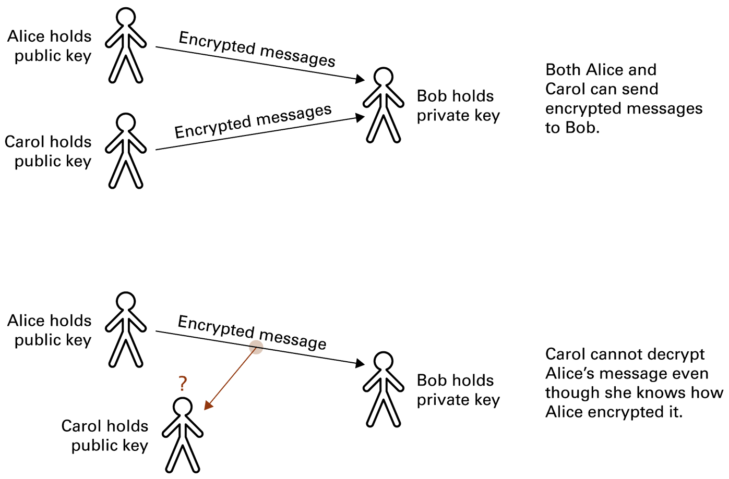
Public-key encryption

Slide 97
Computer crime

Slide 98
Computer Crime
cyber crime, e-crime, electronic crime, or hi-tech crime.
Computer crime is an act performed by a knowledgeable computer user, sometimes referred to as a hacker that illegally browses or steals a company's or individual's private information.
In some cases, this person or group of individuals may be malicious and destroy or otherwise corrupt the computer or data files.

Slide 99
Computer crime
Child pornography - Making or distributing child pornography.
Copyright violation - Stealing or using another person's copyrighted material without permission.
Cracking - Breaking or deciphering codes that are being used to protect data.
Cyber terrorism - Hacking, threats, and blackmailing towards a business or person.
Cyberbully or Cyberstalking - Harassing or stalking others online.
Cybersquatting - Setting up a domain of another person or company with the sole intentions of selling it to them later at a premium price.
Creating Malware - Writing, creating, or distributing malware (e.g., viruses and spyware.)
Denial of Service attack - Overloading a system with so many requests it cannot serve normal requests.
Espionage - Spying on a person or business.
Notes:
Espionage: gián điệp
Squatt: câu/mồi
malware: malicious software

Slide 100
Computer crime
Fraud - Manipulating data, e.g., changing banking records to transfer money to an account or participating in credit card fraud.
Harvesting - Collect account or other account related information on other people.
Human trafficking - Participating in the illegal act of buying or selling other humans.
Identity theft - Pretending to be someone you are not.
Illegal sales - Buying or selling illicit goods online including drugs, guns, and psychotropic substances.
Intellectual property theft - Stealing practical or conceptual information developed by another person or company.
IPR violation - An intellectual property rights violation is any infringement of another's copyright, patent, or trademark.
Phishing - Deceiving individuals to gain private or personal information about that person.

Slide 101
Computer crime
Salami slicing - Stealing tiny amounts of money from each transaction.
Scam - Tricking people into believing something that is not true.
Slander - Posting libel or slander against another person or company.
Software piracy - Copying, distributing, or using software that is copyrighted that you did not purchase.
Spamming - Distributed unsolicited e-mail to dozens or hundreds of different addresses.
Spoofing - Deceiving a system into thinking you are someone you really are not.
Typosquatting - Setting up a domain that is a misspelling of another domain.
Unauthorized access - Gaining access to systems you have no permission to access.
Wiretapping - Connecting a device to a phone line to listen to conversations.
Notes:
Samali slicing: samali (xúc xích Ý)/cut to small fraction
Scam: mưu đồ bất lương
Slander: vu khống/vu cáo/phỉ bang
Spoof: bắt chước
Deceive: lừa gạt

Slide 102
Cyberbully
Alternatively referred to as a cyberstalker, a cyberbully is someone who posts inappropriate or unwanted things about another person, or otherwise harasses them in e-mails, IMs, or SMS.

Slide 103
Spyware
Spyware or snoopware
a software program that is intentionally installed on a computer by to monitor what other users of the same computer are doing.
a program designed to gather information about a user's activity secretly. Spyware programs are often used to track users' habits to target them with advertisements better.

Slide 104
Computer fraud
Computer fraud
any act using computers, the Internet, Internet devices, and Internet services to defraud people, companies, or government agencies of money, revenue, or Internet access.
Illegal computer activities include phishing, social engineering, viruses, and DDoS attacks are some examples used to disrupt service or gain access to another's funds.
Notes:
Fraud: lừa gạt /frod/
Defraud: giành cho được

Slide 105
Identity theft
Identity theft is the act of a person obtaining information illegally about someone else.
Thieves try to find such information as full name, maiden name, address, date of birth, social security number, passwords, phone number, e-mail, and credit card numbers.
The thief can then use this information to gain access to bank accounts, e-mail, cell phones, identify themselves as you, or sells your information.

Slide 106
Phishing
describe a malicious individual or group of individuals who scam users.
They do so by sending e-mails or creating web pages that are designed to collect an individual's online bank, credit card, or other login information. Because these e-mails and web pages look like legitimate companies users trust them and enter their personal information.

Slide 107
Quiz

Slide 108
Quiz
Which of the following best describes the Internet?
A network of interlinked computers
A communications network
An information network
All of the above
Notes:
Answer: d All of the above. The Internet is a network of interlinked computers accessible worldwide. It facillitates communication by way of email, forums, chatrooms and blogs and hosts information and content ranging from online newspapers to wikis.

Slide 109
Quiz
When was the first Internet network started?
1969
1983
1987
1996
Notes:
Answer: a The first Internet started in 1969. It started as a series of networked computers set up at The University of California, Los Angeles, called ARPANET. The first node was switched on on October 29, 1969. In 1983 the Internet was created over a wide network area when the US National Science Foundation created a university wide net NSFnet.

Slide 110
Quiz
The Internet was originally developed by whom?
computer hackers
corporation
the U.S. Department of Defense
the University of Michigan

Slide 111
Quiz
Where do files live on the Internet?
On your computer
On one massive computer - the www
On individual computers, often known as servers
On a network of routers
Notes:
Answer: c Files on the Internet live on individual computers, often known as servers. A server can be a computer or software running on a computer that provides services to other computers, such as hosting Internet files. A server can also act as a client, requesting and viewing web pages.

Slide 112
Quiz
Who writes the rules for the Internet?
No-one
The government of the country in which the Internet is being used
The Internet Society
Your parents
Notes:
Answer: a No-one. The Internet is not governed by any one body. The Internet Society works to create standards for the Internet, such as which standard of Internet Protocol (IP) is used. In countries such as China the government uses software to block certain sites and sections of the net. Children may also have their access to the net limited by their parents.

Slide 113
Quiz
Which of the following is a TRUE statement?
You are free to copy information you find on the Web and include it in your research report.
You do not have to cite the Web sources you use in your research report.
You should never consult Web sources when you are doing a research report.
Just like print sources, Web sources must be cited in your research report. You are not free to plagiarize information you find on the Web.

Slide 114
Quiz
What is the World Wide Web?
computer game
software program
the part of the Internet that enables information-sharing via interconnected pages
another name for the Internet

Slide 115
Quiz
What does URL stand for?
Unique Records List
Uniform Resource Locator
Undefined Restricted Learner
Universal Robot Location
Notes:
b) Uniform Resource Locator.

Slide 116
Quiz
Which of the following is used to translate between IP addresses and mnemonic addresses?
File server
Mail server
Name server
FTP server

Slide 117
Quiz
Which of the following is not a means of connecting networks?
Switch
Server
Router
Bridge

Slide 118
Quiz
Which of the following is not an email related protocol?
HTTP
POP3
IMAP
SMTP

